Slide 1
Chapter 5 Management of Smart Devices
By
Dr. Nilesh Patil

Slide 2
Contents
Managing Smart Devices in Virtual Environments
Managing Smart Devices in Human User-Centred Environments
Managing Smart Devices in Physical Environment
Duration: 10 Hours

Slide 3
Introduction
System management concerns collecting information about the operation of a system and making operational and strategic decisions to actively maintain or modify the system operation.
Three main management activities to maintain the operation of a system:
monitoring to detect management change events;
prevention to control and handle management change events through the use of configurations and policies; and
correction: to handle disruptive causes of management changes and faults that result from management events.

Slide 4
Managing Smart Devices in Virtual Environments
Management of smart devices in virtual (ICT) environments is first considered from different viewpoints such as the data processing and the network viewpoint of ICT systems.
Then device management is considered concerning which system functions are managed and the type of challenges are described.

Slide 5
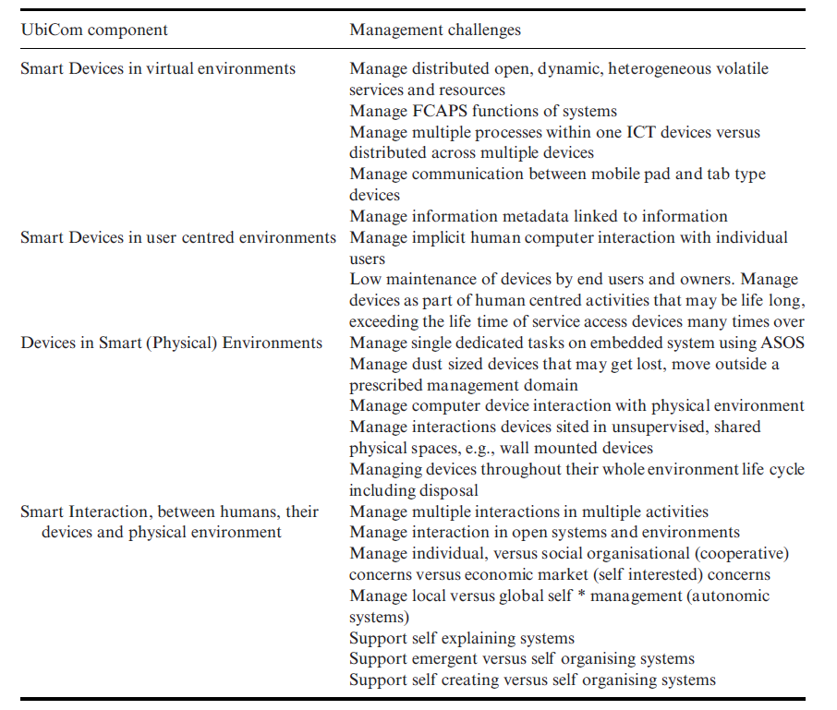
Management requirements for smart devices

Slide 6
1. Process and Application Management
The device operating system (MTOS) facilitates the execution of multiple concurrent process applications on smart devices by managing memory, process control, and communication seamlessly.
It ensures fairness by preventing processes from monopolizing CPU and I/O resources or overwriting memory.
In energy-constrained devices, the OS employs power-saving techniques to manage limited energy efficiently.
Additionally, in mobile devices, it supports global network communication for sending and receiving messages.
Various strategies for downloading and installing applications onto smart devices are also explored.

Slide 7
2. Network-Oriented Management
The network perspective of ICT systems comprises computer nodes and network elements connecting them.
While network management and system management are distinct concepts, they are interconnected.
Network management involves overseeing communication services on network elements like hubs, switches, routers, gateways, and modems, typically utilizing models like SNMP and often running on ASOS computers.
On the other hand, system management focuses on maintaining application services on MTOS computer systems at the network edge, influenced by telecommunications network management initiatives such as the FCAPS (fault, configuration, accounting, performance, and security) model.
In many single media content networks, essential communication functions and services are primarily managed at the core network level.
However, there is a noticeable shift towards service-oriented network management, focusing on physical signal distribution, data encoding, channel sharing, error checking, and data transfer control. Regarding heterogeneous content and applications with varied requirements for jitter, delays, and packet loss, two approaches are evident.
One approach advocates keeping core functions and network routing elements simple, handling diverse requirements at the network edges within applications.
The alternative approach involves enhancing core network support to better manage the diverse needs of heterogeneous media. This can be achieved using IPv4 protocols like MPLS, Diffserv, and RSVP, or by leveraging IPv6.

Slide 8
FCAPS
Standardization of common network management functions referred to as FCAP
FCAPS functions define basic requirements for managing distributed computers and hence UbiCom systems.
The Telecommunication Network Management (TNM) model for managing Open Systems within a telecommunications network defines four logical layers.
FCAPS management functions spread across these logical layers.
Many computer service vendors offer client-server type implementations of FCAPS functions via various APIs,
Can support via
SNMP.
ICMP
HTTP
Open source implementations

Slide 9
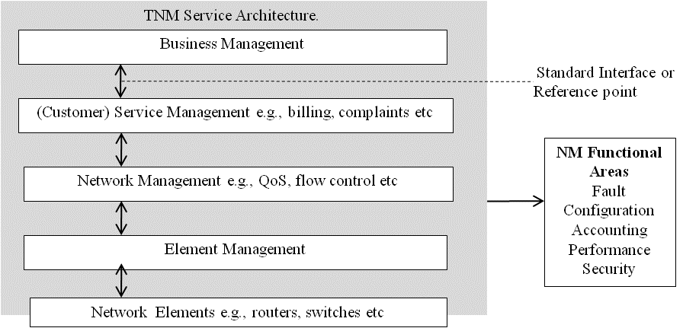
TNM Model

Slide 10
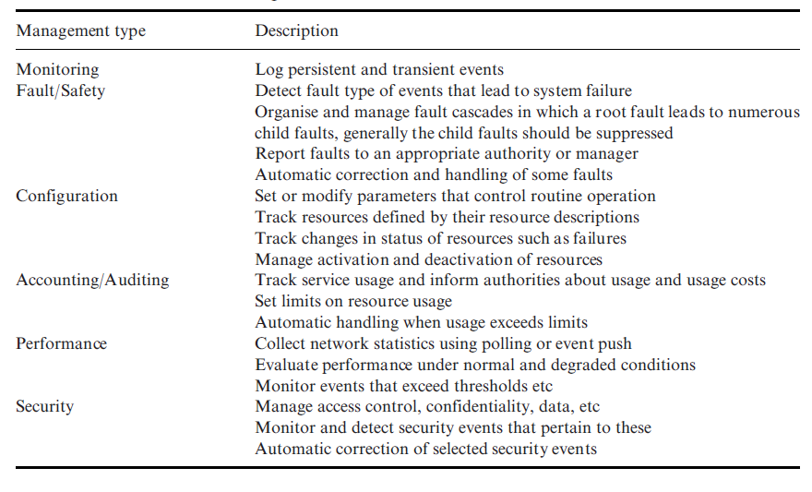
FCAPS network management functions

Slide 11
Monitoring and Accounting
Monitoring obtains the information required to support management functions. Typical information includes usage, current status snapshots, status changes, and unusual event reports.
Monitoring can be configured as follows in terms of: how often to save the system status and what the system status saved is, e.g., the difference from a previously saved state or as a stand-alone state.
Monitoring involves three separate processes, analysis, filtering, and auditing.
Analysis involves gathering and correlating distributed information. This may need conversion into a common format and to compare events with a history and the use of case-based patterns.
Filtering involves reducing and selecting events based upon predefined rules in order to reduce information overload and storage, e.g., notify something if anyone accesses a particular system between 18:00 and 08:00 hours.
Filters need to support selective archiving by end users and should be user-configurable.
Two main methods or protocols to monitor networked devices or hosts are to use ICMP or SNMP.

Slide 12
Monitoring and Accounting
Accounting Management records the use of resources and services by individuals and by groups, e.g. by department.
This can also be used to calculate the variable cost of usage and to support itemized billing.
However, this is also useful even when there is a fixed, e.g., monthly, cost for usage.
Accounting can be used to trigger rules to govern fair access, to set usage quotas, to assess longer-term trends and patterns of system use beyond that derived purely from monitoring and so help to plan system evolution and re-configuration.

Slide 13
ICMP
The Internet Control Message Protocol (ICMP) is a core protocol used within the Internet Protocol (IP) suite. Its primary function is to provide error reporting and diagnostic functions.
ICMP messages are typically generated in response to errors in IP datagrams or for diagnostic or control purposes.
A sender process on one computer node sends an ICMP echo request message to a receiver process on another node which should respond with an ICMP echo response message.
An ICMP timestamp indicates the message Round Trip Time and is used to measure network performance.
Key features of ICMP include:
Error Reporting: ICMP is responsible for reporting errors encountered during the processing of IP datagrams. For example, if a router encounters a problem forwarding a packet, it may send an ICMP message back to the source indicating the issue.
Ping: ICMP includes a feature known as "ping," which is used to test the reachability of a host on an IP network and measure the round-trip time for packets to travel to the destination and back.
Path MTU Discovery: ICMP can be used to discover the maximum transmission unit (MTU) along a path between two hosts. This helps prevent packet fragmentation and ensures efficient data transmission.
Router Discovery: ICMP Router Discovery messages allow hosts to discover routers on their local network segment, enabling them to configure their routing tables automatically.
Network Troubleshooting: ICMP messages are valuable for network troubleshooting, providing feedback about network connectivity issues, unreachable hosts, and other network-related problems.

Slide 14
SNMP (Simple Network Management Protocol)
Main components of SNMP model consist of:
Network elements: things to be managed or not
Agent: the management processes that execute as processes in the network element and are used to monitor and filter events, such as to dynamically assign an IP address, buffer overflow proxies
Managers: query information from agents, process and store the information
Management Database (MDB) or Management Information Base (MIB): used to store information about the network elements for use by managers.

Slide 15
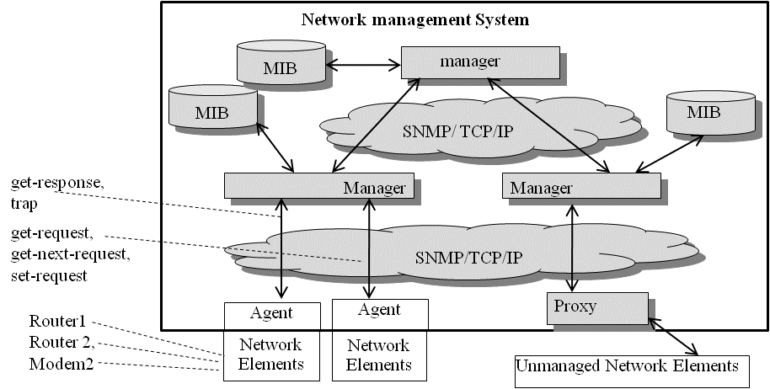
Basic architecture for network management

Slide 16
Advantages of SNMP
It can support a range of FCAPS management functions.
It supports an asynchronous application protocol that can handle volatile communication and it supports low-resource agent processes, however, resource managers are often resource hungry and are complex to maintain.

Slide 17
Limitations of SNMP
SNMP MIB data structures are complex and need to be specified at a low level of detail.
SNMP is not in-built into many devices but these can be treated as unmanaged and managed by proxies.
SNMP is oriented to a single user, managed devices.
SNMP requires a high degree of technical ability and is not suitable for many end users without usable SNMP tools.

Slide 18
ICMP Vs SNMP
Characteristic | ICMP | SNMP
Purpose | Diagnostic and error reporting protocol for IP networks | Network management protocol for monitoring and configuring network devices
Layer | Network Layer (Layer 3) | Application Layer (Layer 7)
Communication Model | Request-Response | Manager-Agent
Messaging | Error messages, diagnostic information, and control messages | Get, GetNext, Set, Trap
Packet Format | ICMP Header + Data | SNMP Message
Supported Operations | Echo Request/Reply, Destination Unreachable, Time Exceeded, etc. | Get, GetNext, GetBulk, Set, Trap
Devices Involved | End hosts and routers | Network devices (routers, switches, servers, etc.) and Network Management Station (NMS)
Security | No built-in security mechanisms | Supports various security models (v1, v2c, v3)
Applications | Troubleshooting network connectivity issues, path MTU discovery, etc. | Network monitoring, configuration management, performance monitoring, fault management
Transport Protocol | IP (Internet Protocol) | UDP (User Datagram Protocol)

Slide 19
Configuration Management
A configuration is used as a specification of the settings of the attributes that can be modified and any invariant attributes, such as an identification code, that characterize a user device.
Objectives:
Set or modify parameters that control routine operation
Track resources defined by their resource descriptions
Track changes in status of resources such as failures
Manage activation and deactivation of resources
Configuration management involves four main management functions:
identification of the configuration,
change control (or change management),
accounting and verification and
auditing.

Slide 20
ReConfiguration Management
Side effects of reconfiguration
Systems need to interrupt their service and reboot themselves for reconfiguration changes to take effect.
Configuration conflicts may also become common in multi-domains managed UbiCom systems
Users can misconfigure devices
Easing Configuration & Avoiding Misconfiguration
Ideally, zero manual configuration of devices by users.
Devices should support automatic remote service discovery
Devices should support automatic device installation

Slide 21
Fault Management
A fault is defined as the cause of one or more observed error, or abnormal, events.
Fault Management or Safety management concerns maintaining core ICT service operations.
Sometimes, fault management overlaps with security management.
Detect the fault type of events that lead to system failure.
Organise and manage fault cascades in which a root fault leads to numerous child faults, generally the child faults should be suppressed.
Report faults to an appropriate authority or manager.
Deals with Automatic correction and handling of some faults.

Slide 22
Fault Management
Fault management is crucial for maintaining the operation of critical infrastructures through monitoring, detecting, preventing and anticipating anomaly events
E.g., utility distribution, telecomms, transport, logistics, intelligent HVAC, banking, medicine etc.
Fault or safety management involves:
fault prevention,
fault prediction,
fault event monitoring,
fault detection,
fault diagnosis,
fault handling
fault-tolerance.

Slide 23
Performance Management
Collect network statistics using polling or event push
Evaluate performance under normal and degraded conditions
Monitor events that exceed thresholds etc.
Sometimes it may not be possible to specify absolute single-point boundaries for the system
There are several specific ways to manage performance:
Best effort
QoS
SLA.

Slide 24
Security management
Security management concerns
assessment of risk of threats which cause some loss of value to system assets
heightened through any system vulnerabilities or weaknesses and developing
maintaining appropriate safeguards or security controls to protect assets against threats
3 basic types of safeguard:
Detection: e.g., periodic system audits and scans; integrity checks and checksums are used to identify modifications to stored information, messages and code; digital signatures can be used to attest who has written what.
Prevention: e.g., encrypting confidential data to prevent eavesdropping; authentication based upon strong passwords and certificates
Correction: handle what has happened after a threat has occurred, e.g., countermeasures such as blacklisting and blocking access from users and networks that were sources of previous threats
Both detection and correction offer a priori protection
Correction offers a posterior protection.

Slide 25
Security Safeguards
UbiCom System security can be modelled in terms of:
Viewpoints of sets of Safeguards that protect the system Assets (the items of value in a system)
against Threats (actions that actively ↓ value of assets)
V-SAT model of security

Slide 26
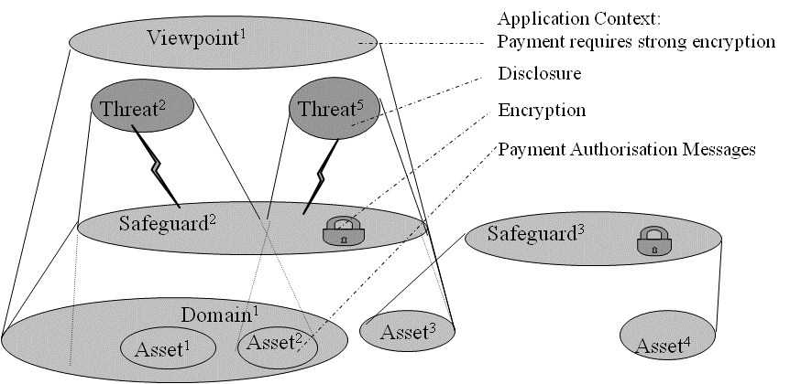
V-SAT Model for Security Management
Example
Threat
Sender masquerade
Asset
Information about real sender shared with fake sender
Actions requested by a fake sender are performed by receiver.
Safeguards
Authenticate caller identity
Call back real sender
Strong password based access control

Slide 27
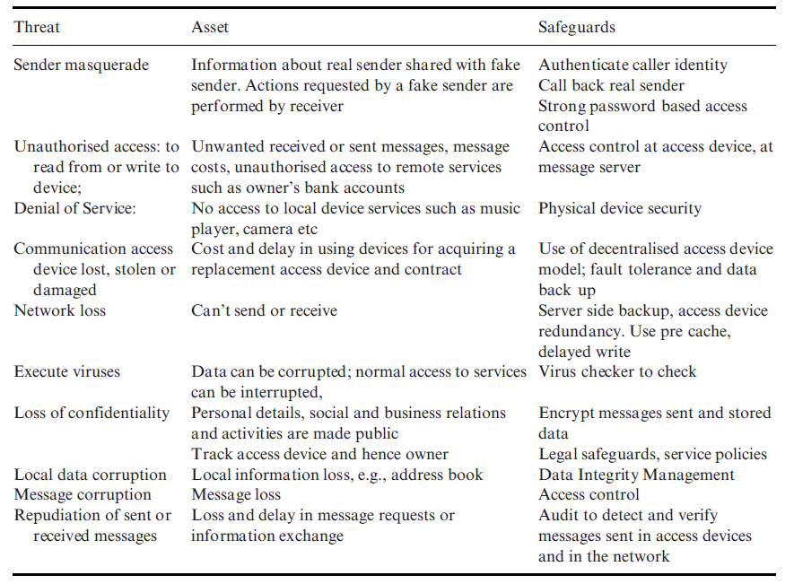
Relation between threats, assets and safeguards from the viewpoint of the user of a smart mobile device

Slide 28
Rich Vs Lean Information
Sr. No. | Rich Information | Lean Information
1 | Rich information typically refers to data that is detailed, comprehensive, and contains a high level of complexity. | Lean information, on the other hand, refers to data that is simplified, condensed, or reduced in complexity.
2 | It often includes multimedia content, such as high-resolution images, videos, audio recordings, or detailed text. | It often contains only essential or summarized information, omitting unnecessary details.
3 | Rich information provides a complete and thorough representation of the underlying concept or idea. | Lean information focuses on providing just enough data to convey the necessary message or achieve the desired functionality.
4 | Examples of rich information in ubiquitous computing might include high-definition video streams, detailed sensor readings, or complex databases. | Examples of lean information in ubiquitous computing could be simple status updates, summarized sensor data, or abbreviated notifications.
5 | Rich information might be necessary for tasks requiring in-depth analysis or detailed presentation. | Lean information might be more suitable for efficient communication or quick decision-making in resource-constrained or real-time scenarios.

Slide 29
Hard Vs Soft Information
Sr. No. | Hard Information | Soft Information
1 | Hard information typically refers to data that is objective, quantifiable, and precise. | Soft information, on the other hand, refers to data that is subjective, qualitative, or context-dependent.
2 | It consists of concrete, measurable facts and figures that are often obtained through sensors, instruments, or direct measurements. | It often includes descriptive or interpretive content that cannot be easily quantified or precisely measured. Soft information may involve human perceptions, opinions, emotions, or cultural nuances.
3 | Hard information is characterized by its high reliability and accuracy, as it is based on empirical evidence. | Soft information is typically more open to interpretation and may vary depending on individual perspectives or situational factors.
4 | Hard information provides objective insights and supports data-driven decision-making. | Soft information adds richness and context to the understanding of user behavior, preferences, and interactions with the system.
5 | Examples of hard information in ubiquitous computing might include temperature readings, GPS coordinates, sensor measurements, or numerical data from experiments. | Examples of soft information in ubiquitous computing could be user preferences, social interactions, contextual cues, or natural language text.

Slide 30
Micro-sized Devices Vs nano-Sized Devices.
Characteristic | Micro-sized Devices | Nano-sized Devices
Size Range | Few millimeters to a few centimeters | 1 to 100 nanometers
Applications | Wireless sensor networks, wearable technologies, smart home systems | Nanoelectronics, nanomedicine, nanoscale sensing
Capabilities | Integrate sensors, actuators, processors, communication modules | Exhibit unique properties due to small scale (quantum effects, high surface-to-volume ratio)
Power and Energy | Require more power and energy | Operate with very low power consumption
Integration and Deployment | Integrated into larger systems or everyday objects | Incorporated into materials, coatings, or biological systems
Manufacturing and Cost | Conventional semiconductor fabrication techniques, relatively more accessible and cost-effective | Advanced manufacturing techniques (nanolithography, self-assembly), often more complex and expensive

Slide 31
Managing Multimedia Data (1/2)
Managing multimedia content in ubiquitous computing involves various strategies and technologies to ensure seamless access, storage, transmission, and presentation of multimedia data across diverse devices and contexts. Here are some key aspects of how multimedia content is managed in ubiquitous computing:
Data Formats and Standards: Standardized formats and protocols are essential for interoperability across different devices and platforms. Multimedia content may be encoded using formats such as JPEG, PNG, MP4, or WAV, and transmitted using protocols like HTTP, RTSP, or RTP.
Content Distribution and Delivery: Content delivery networks (CDNs) and peer-to-peer (P2P) networks are often used to distribute multimedia content efficiently to users across geographically dispersed locations. Adaptive streaming techniques, such as MPEG-DASH or HLS, enable dynamic adjustment of video quality based on network conditions and device capabilities.
Storage and Retrieval: Multimedia content may be stored in distributed storage systems, cloud storage services, or content management systems. Metadata indexing and search capabilities facilitate efficient retrieval of specific multimedia assets based on content descriptors, keywords, or user preferences.
Content Adaptation and Transcoding: To ensure compatibility with diverse devices and network conditions, multimedia content may undergo adaptation or transcoding processes. These processes involve converting content into different formats, resolutions, or bitrates to optimize delivery and playback on target devices.

Slide 32
Managing Multimedia Data (2/2)
Context Awareness: Ubiquitous computing environments leverage context-awareness to personalize the delivery and presentation of multimedia content based on user preferences, device capabilities, location, and environmental factors. Context-aware systems use sensors, contextual information, and user profiles to adapt multimedia content dynamically.
Security and Privacy: Robust security measures are essential to protect multimedia content from unauthorized access, tampering, or distribution. Encryption techniques, access control mechanisms, and digital rights management (DRM) solutions help safeguard multimedia content and ensure compliance with privacy regulations.
Synchronization and Collaboration: In collaborative ubiquitous computing scenarios, multimedia content may be synchronized across multiple devices and users in real-time. Synchronization protocols and collaborative editing tools enable seamless sharing and collaboration on multimedia content, fostering interactive and participatory experiences.
Quality of Service (QoS) Management: QoS management mechanisms prioritize multimedia content delivery based on factors such as bandwidth availability, latency requirements, and user preferences. Quality metrics such as bitrate, resolution, frame rate, and audio fidelity are optimized to enhance the user experience.

Slide 33
Management of services with SLA
Service Level Agreements (SLAs) are formal agreements between service providers and service consumers that define the expected levels of service quality, performance, availability, and other relevant metrics.
In the context of ubiquitous computing, SLAs play a vital role in managing the diverse range of services and ensuring that they meet the agreed-upon requirements.
Some key aspects of managing services with SLAs in ubiquitous computing:
Service Discovery and Composition
Service Quality and Performance Monitoring
Resource Management and Allocation
Context-Awareness and Adaptation
Fault Tolerance and Reliability
Security and Privacy
Service Lifecycle Management
SLA Negotiation and Management

Slide 34
1. Service Discovery and Composition
In a ubiquitous computing environment, services may be provided by various devices and systems distributed across different locations.
Service discovery mechanisms are necessary to identify and locate the available services.
Service composition techniques enable the integration of multiple services to create more complex functionalities.

Slide 35
2. Service Quality and Performance Monitoring
SLAs typically specify quantitative and qualitative measures for service quality and performance, such as response time, throughput, availability, and reliability.
Continuous monitoring of these metrics is essential to ensure that the services are meeting the agreed-upon service levels.

Slide 36
3. Resource Management and Allocation
Ubiquitous computing environments often involve resource-constrained devices and dynamically changing conditions.
Effective resource management and allocation strategies are necessary to ensure that the required resources (e.g., network bandwidth, processing power, storage) are available to meet the service levels specified in the SLAs.

Slide 37
4. Context-Awareness and Adaptation
Ubiquitous computing systems should be capable of adapting to changing contexts and user preferences.
SLAs may need to be dynamically adjusted or renegotiated based on factors such as user mobility, device capabilities, network conditions, and environmental factors.

Slide 38
5. Fault Tolerance and Reliability
In a distributed and dynamic environment, services may experience failures or disruptions.
Mechanisms for fault tolerance, redundancy, and failover are crucial to maintain the required service levels and meet the SLA requirements.

Slide 39
6. Security and Privacy
Ubiquitous computing environments often involve sensitive data and personal information.
SLAs should address security and privacy concerns, specifying measures for data protection, access control, and compliance with relevant regulations.

Slide 40
7. Service Lifecycle Management
SLAs should cover the entire lifecycle of services, including service deployment, updates, versioning, and decommissioning.
Proper management of service lifecycles ensures seamless transitions and minimizes service disruptions.

Slide 41
8. SLA Negotiation and Management
Mechanisms for negotiating, monitoring, and enforcing SLAs are necessary in ubiquitous computing environments.
This may involve automated negotiation algorithms, service brokers, and tools for SLA management and reporting.

Slide 42
Information Management in UbiCom System Management
Information management in UbiCom systems encompasses various aspects to ensure efficient and effective handling of data and information.
Here are the several factors to be considered for Information Management:
Information Application
Rich Vs Lean Information
Hard Vs Soft Information
Managing the Information Explosion
Managing the multimedia data
Managing Metadata

Slide 43
1. Information Application
In UbiCom systems, information management strategies should ensure that the right information is delivered to the right applications and services at the right time.
This involves understanding the information needs of different applications, such as context-aware services, decision support systems, and user interfaces.
Information management techniques should enable the seamless integration and utilization of information by various applications and services within the UbiCom environment.

Slide 44
2. Rich Vs Lean Information
UbiCom systems deal with both rich and lean information.
Rich information refers to detailed, comprehensive, and context-rich data, such as multimedia content, sensor data, and user profiles.
Lean information, on the other hand, consists of condensed or summarized data, such as notifications, alerts, and status updates.
Information management strategies should handle both types of information effectively, ensuring that rich information is preserved for in-depth analysis and lean information is delivered promptly for real-time decision-making and user interaction.

Slide 45
3. Hard Vs Soft Information
Hard information refers to quantitative, objective, and verifiable data, such as sensor readings, location data, and system logs.
Soft information, on the other hand, includes subjective, qualitative, and context-dependent data, such as user preferences, opinions, and social interactions.
Information management in UbiCom systems should accommodate both hard and soft information, as they provide complementary insights and contribute to a comprehensive understanding of the user's context and needs.

Slide 46
4. Managing the Information Explosion
UbiCom systems generate massive amounts of data from various sources, leading to an information explosion.
Effective information management strategies are crucial to handle this data deluge.
Techniques such as data compression, aggregation, filtering, and archiving can help manage the information overload.
Additionally, information prioritization and intelligent caching mechanisms can ensure that the most relevant and time-sensitive information is readily available, while less critical data is stored or discarded based on predefined policies.

Slide 47
5. Managing Multimedia Data
UbiCom systems often deal with multimedia data, such as images, videos, audio, and sensor data streams.
Managing multimedia data presents unique challenges in terms of storage, processing, and delivery.
Information management strategies should incorporate techniques for efficient multimedia data compression, indexing, and retrieval.
Additionally, content-based analysis and annotation of multimedia data can enhance its usability and enable more effective information retrieval and decision-making.

Slide 48
6. Managing the Metadata
Metadata, or data about data, plays a crucial role in UbiCom systems. Metadata provides contextual information about the data itself, such as its source, creation date, format, and semantics.
Effective information management strategies should include mechanisms for capturing, storing, and utilizing metadata.
Metadata can facilitate data discovery, integration, and interpretation, enabling more efficient information management and enabling advanced features like semantic search and knowledge representation.

Slide 49
Privacy-Invasive Technologies
Privacy-invasive technologies in ubiquitous computing are those that have the potential to compromise an individual's privacy by collecting, processing, and sharing personal information without proper consent or protection measures. These technologies can pose significant risks to users' privacy. Some examples include:
Pervasive Tracking and Monitoring: Technologies such as RFID tags, GPS tracking, and surveillance cameras can be used to monitor and track individuals' movements, activities, and behaviors without their knowledge or consent.
Sensor Networks: Networks of sensors embedded in the environment can collect and transmit various types of data, including audio, video, and environmental information, potentially exposing sensitive personal information.
Data Mining and Profiling: Advanced data mining and profiling techniques can be used to analyze and combine data from multiple sources, creating detailed profiles of individuals' preferences, habits, and behaviors.
Ubiquitous Computing Devices: Devices like smartphones, wearables, and smart home assistants can collect and transmit personal data, such as location, voice recordings, and user interactions, without adequate privacy controls.

Slide 50
Privacy-Enhanced Technologies
Privacy-enhanced technologies in ubiquitous computing are designed to protect users' privacy and ensure the responsible collection, processing, and sharing of personal information. These technologies aim to empower individuals with control over their data and provide mechanisms for privacy preservation. Some examples include:
Privacy-Preserving Data Mining: Techniques such as differential privacy, k-anonymity, and secure multi-party computation allow data analysis and mining while protecting individual privacy by introducing controlled noise or anonymization.
Privacy-Aware Architectures: Architectural designs that incorporate privacy principles from the ground up, such as decentralized data storage, end-to-end encryption, and access control mechanisms, can help mitigate privacy risks.
Privacy-Enhancing Technologies (PETs): PETs like anonymous credentials, private information retrieval, and privacy-preserving biometrics enable individuals to selectively disclose or withhold personal information while maintaining privacy.
User-Centric Privacy Controls: Interfaces and control mechanisms that allow users to manage their privacy preferences, such as consent management, data access controls, and privacy dashboards, can empower individuals to make informed decisions about their personal data.
Privacy-Preserving Protocols: Protocols like secure multi-party computation, homomorphic encryption, and zero-knowledge proofs enable computation on encrypted data or sharing of data without revealing the underlying sensitive information.

Slide 51
Characteristic | Privacy Invasive Technologies | Privacy Enhanced Technologies
Purpose | Collect and utilize personal data from ubiquitous devices and environments, often without user consent | Protect user privacy and data security in ubiquitous computing environments
Examples | Location tracking, smart home monitoring, wearable data collection, IoT device data mining | Encrypted communication between devices, anonymization of user data, privacy-focused device configurations, user consent mechanisms
Data Collection | Continuous and indiscriminate data collection from ubiquitous devices, often without user awareness | Minimized data collection, explicit user consent for data sharing, and privacy-preserving data aggregation
Data Usage | Personal data may be shared, sold, or exploited for commercial or surveillance purposes | Strict policies and technical controls on data usage, limiting access and sharing
User Control | Limited user control over data collection and usage from ubiquitous devices | Users have control over privacy settings, data sharing, and device configurations
Privacy Risks | High risks of privacy violations, data breaches, unauthorized tracking, and profiling | Lower risks due to robust privacy protections and data minimization techniques
Transparency | Often lack transparency about data collection and usage practices from ubiquitous devices | Clear communication about privacy practices and data handling in ubiquitous computing environments
Regulatory Compliance | May violate privacy laws and regulations related to ubiquitous computing and IoT devices | Designed to comply with privacy laws and regulations for ubiquitous computing environments (e.g., IoT privacy guidelines)
Public Perception | Viewed as intrusive and violating user privacy in ubiquitous computing environments | Viewed as trustworthy and respecting user privacy in ubiquitous computing environments
Ethical Considerations | Raise ethical concerns about individual rights, autonomy, and privacy in ubiquitous computing | Align with ethical principles of data protection, user consent, and privacy in ubiquitous computing

Slide 52
Biometric Technique | Description | Advantages | Disadvantages | Ubiquitous Computing Applications
Fingerprint Recognition | Scans and analyzes the unique patterns of an individual's fingerprint | Widely adopted, reliable, cost-effective | Can be affected by physical factors (cuts, dryness), privacy concerns | Access control systems, mobile device authentication, attendance tracking
Facial Recognition | Identifies individuals based on their facial features and patterns | Non-intrusive, contactless, can work in the background | Affected by lighting conditions, angles, occlusions, privacy concerns | Surveillance systems, access control, user identification in smart environments
Iris Recognition | Analyzes the unique patterns of the iris (colored part of the eye) | Highly accurate, stable over time, difficult to spoof | Requires high-quality image capture, user cooperation, privacy concerns | High-security access control, border control, financial transactions
Voice Recognition | Analyzes the unique characteristics of an individual's voice | Non-intrusive, can work remotely, natural user interface | Affected by background noise, voice changes, limited accuracy | Voice-controlled smart home systems, virtual assistants, authentication in IoT devices
Gait Recognition | Identifies individuals based on their unique walking patterns and body movements | Non-intrusive, can work in the background, difficult to spoof | Affected by environmental factors, clothing, carrying objects | Surveillance systems, activity monitoring, smart home security
Signature Recognition | Analyzes the unique characteristics of an individual's handwritten signature | Simple and convenient for verification | Can be forged, affected by physical and emotional factors | Digital document signing, financial transactions, contract authentication
Keystroke Dynamics | Analyzes the unique typing patterns and rhythms of an individual | Non-intrusive, can work in the background, low-cost | Limited accuracy, can be affected by physical and emotional factors | Continuous authentication in computer systems, IoT device access control
Vein Pattern Recognition | Analyzes the unique patterns of blood veins in the palm, fingers, or other body parts | Highly accurate, difficult to spoof, stable over time | Requires specialized hardware, user cooperation, privacy concerns | High-security access control, financial transactions, healthcare applications

